Slide 1
Looping in JavaScript
Understanding for, while, and do while Loops

Slide 2
Introduction to Loops
What are Loops?
Loops allow the execution of a block of code multiple times based on a condition.
Types of Loops in JavaScript:
for Loop
while Loop
do while Loop

Slide 3

The for Loop
Definition: Executes a block of code a specified number of times.
Syntax :

Slide 4
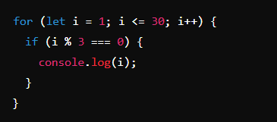
Reasoning with the for Loop
Problem: Print numbers divisible by 3 between 1 and 30.
Code Example:
Explanation:
The loop runs from 1 to 30.
Inside the loop, the if statement checks if the number is divisible by 3.
If true, the number is printed.

Slide 5
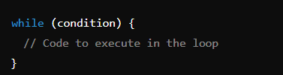
The while Loop
Definition: Executes a block of code as long as a specified condition is true.
Syntax :

Slide 6
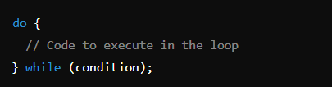
The do while Loop
Definition: Executes a block of code once, then repeats the loop as long as the condition is true.
Syntax :

Slide 7
Comparison of Looping Structures
for Loop:
Best for loops with a known number of iterations.
while Loop:
Best when the number of iterations is not known beforehand.
do while Loop:
Guarantees the loop runs at least once.
Example Scenario:
for Loop: Iterating over a fixed array.
while Loop: Waiting for user input until valid input is given.
do while Loop: Running a menu-driven program at least once.

Slide 8
Summary of Loops
for Loop: Best for known iterations.
while Loop: Best for unknown iterations.
do while Loop: Ensures at least one iteration.
Use Cases: Iterating over data structures, user input validation, and more.

